Slide 1
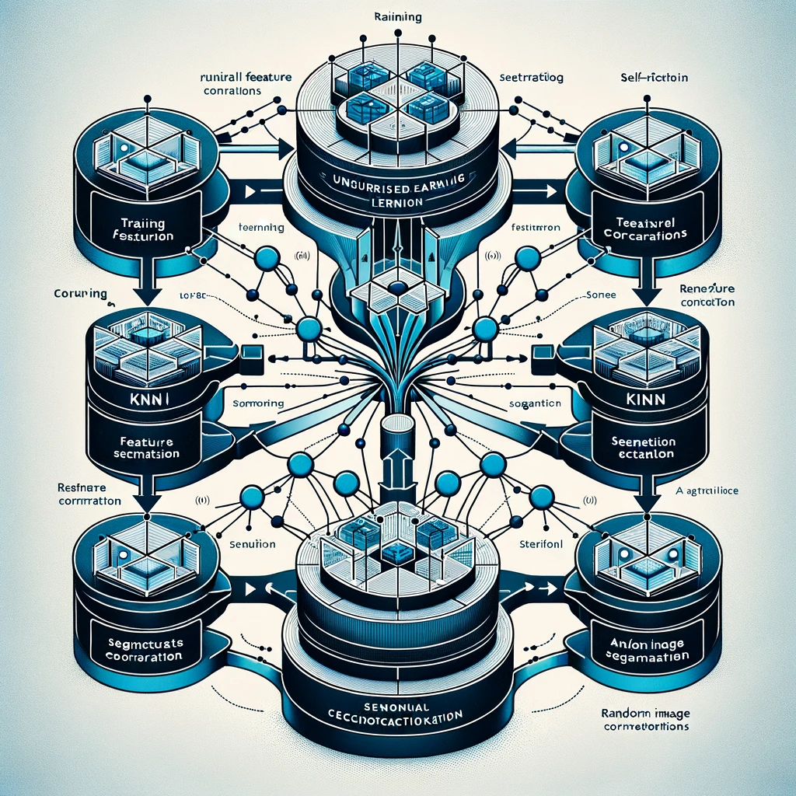
Unsupervised Semantic Segmentation by Distilling Features Correspondences
Paper review
Gibeom Kim (UST)

Slide 2

Index
Paper abstract
1-1. Optical flow
1-2. Correlation layer
1-3. Correlation volume
Model
Conclusion

Slide 3
1. Paper abstract
Unsupervised semantic segmentation model from unlabeled image data
Match the features using feature correspondences and segmentation correspondences between images.
Learns from a variety of patterns and situations through KNN correlations, self-correlations, and random image correlations.
STEGO achieves SOTA performance on both the CocoStuff (+14 mIoU) and Cityscapes (+9 mIoU)(2022)

Slide 4
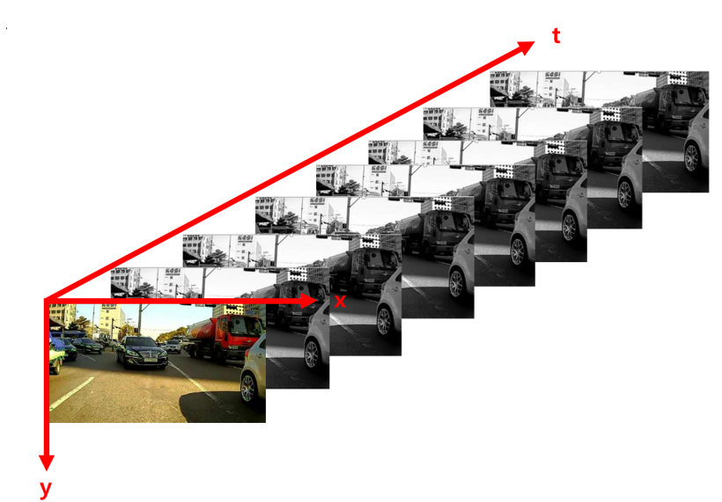
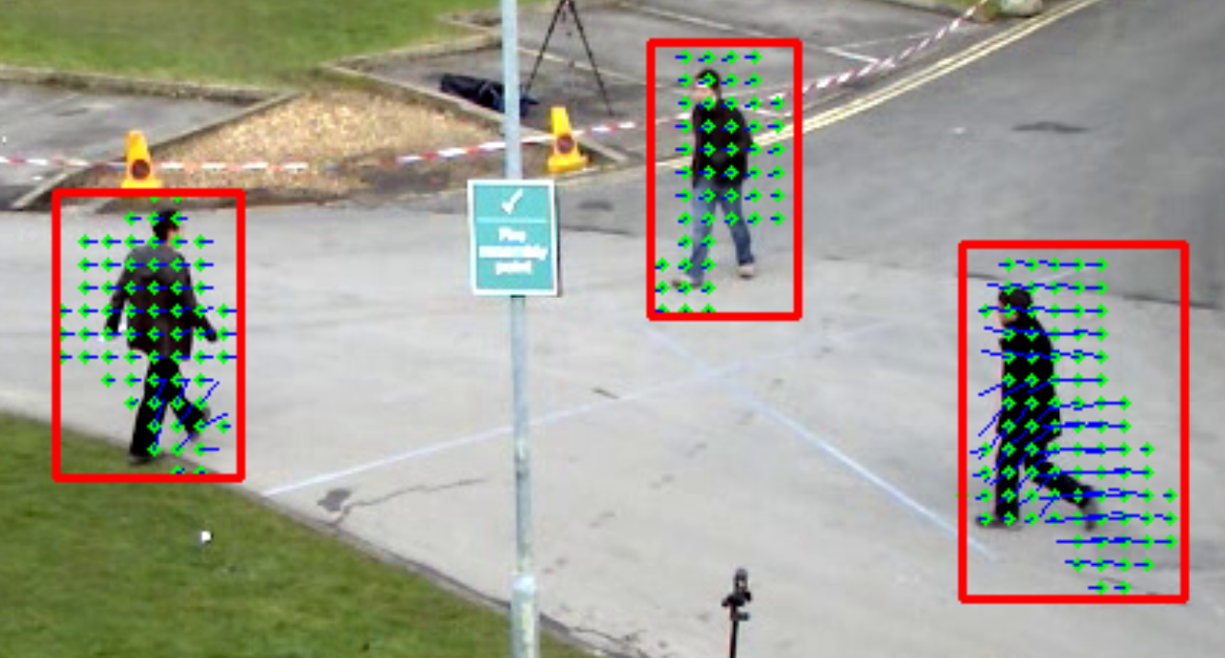
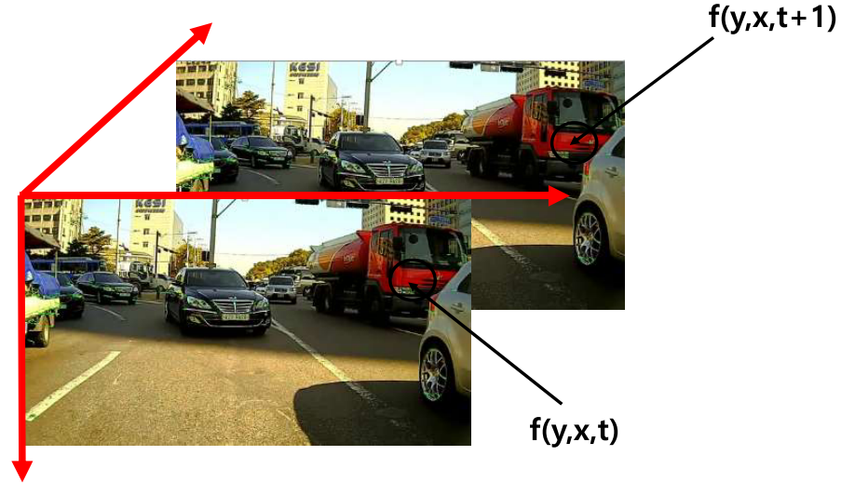
1-1. Optical flow

Slide 5
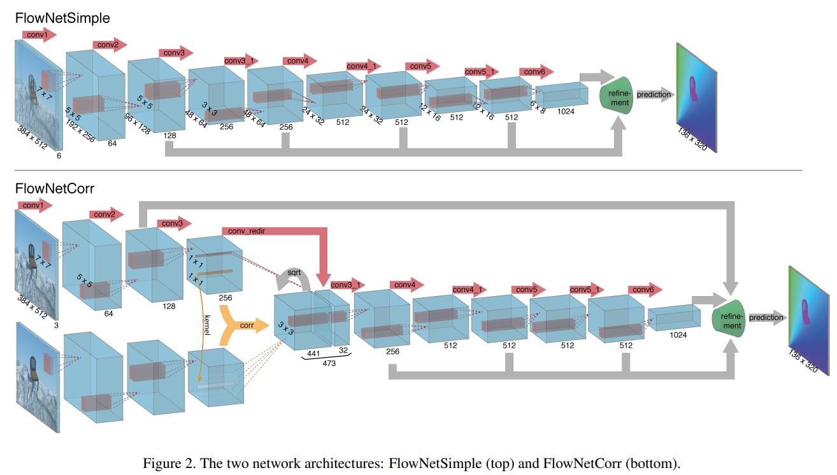
1-2. Correlation layer

Slide 6
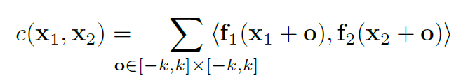
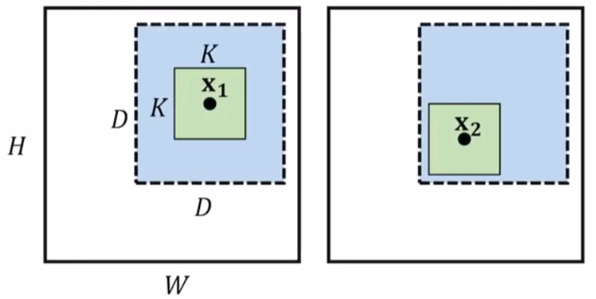
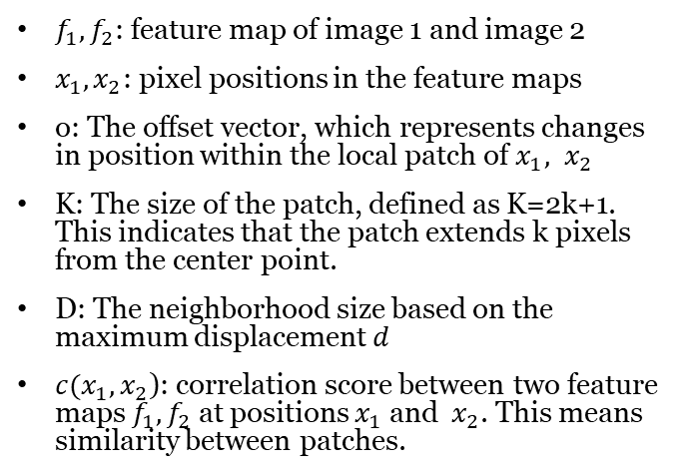
1-2. Correlation layer
$f_{1},f_{2}$: feature map of image 1 and image 2
$x_{1},x_{2}$: pixel positions in the feature maps
o: The offset vector, which represents changes in position within the local patch of $x_{1}, x_{2}$
K: The size of the patch, defined as K=2k+1. This indicates that the patch extends k pixels from the center point.
D: The neighborhood size based on the maximum displacement 𝑑
$c(x_{1},x_{2}$): correlation score between two feature maps $f_{1},f_{2}$ at positions $x_{1}$ and ​ $x_{2}$. This means similarity between patches.

Slide 7
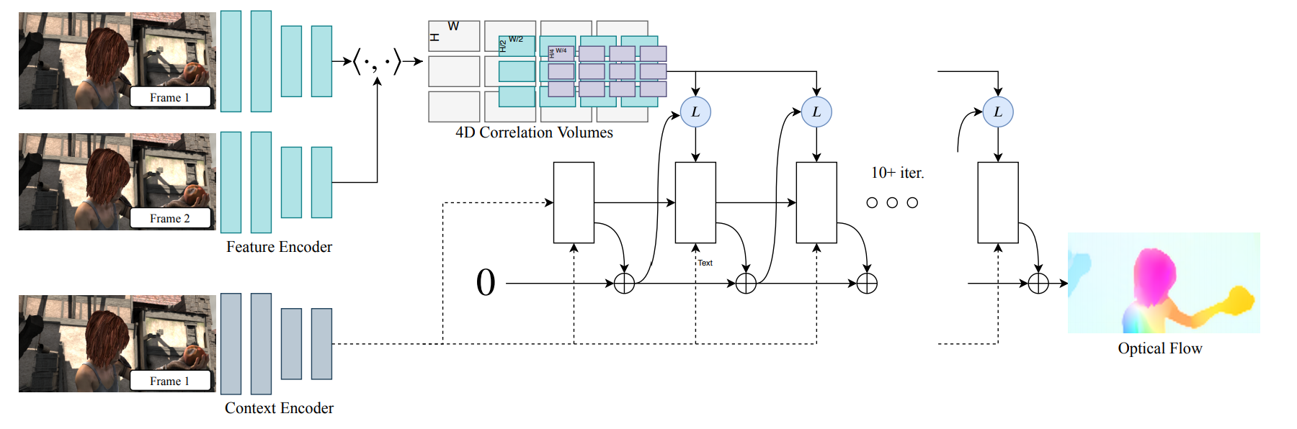
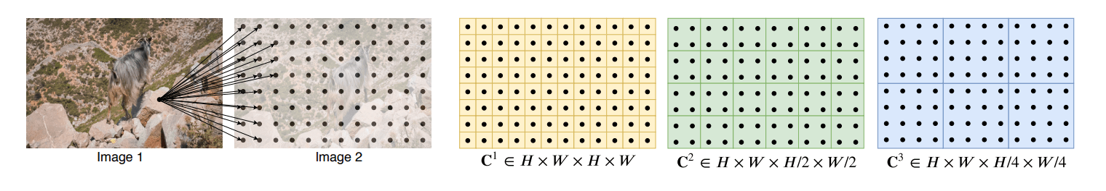
1-3. Correlation volume

Slide 8
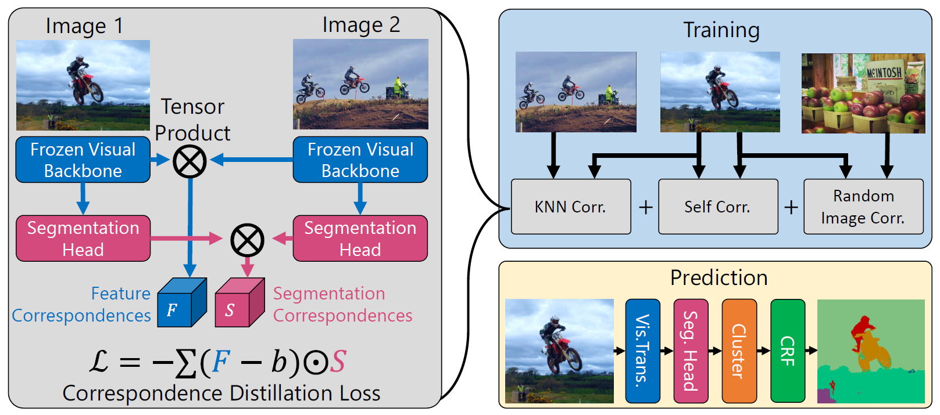
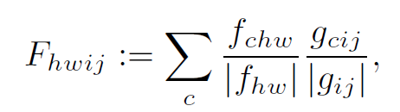
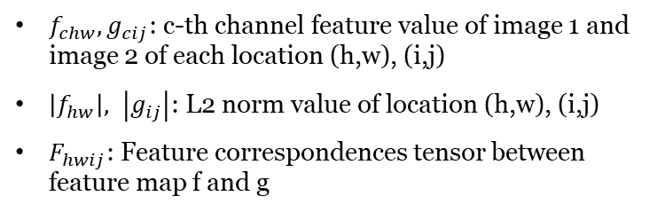
2. Model
$f_{chw},g_{cij}$: c-th channel feature value of image 1 and image 2 of each location (h,w), (i,j)
$\left|f_{hw}\right|, \left|g_{ij}\right|$: L2 norm value of location (h,w), (i,j)
$F_{hwij}$: Feature correspondences tensor between feature map f and g

Slide 9
2. Model
KNN Correlation
Self Correlation
Random image Correlation

Slide 10
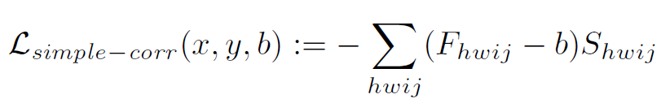
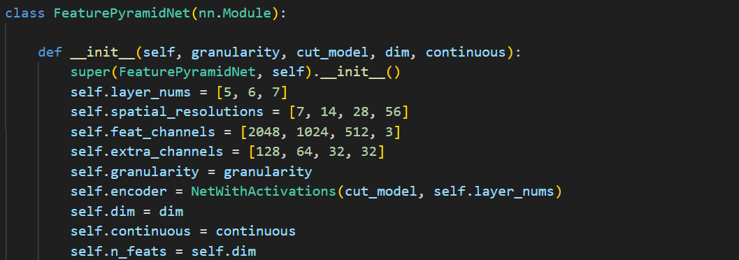
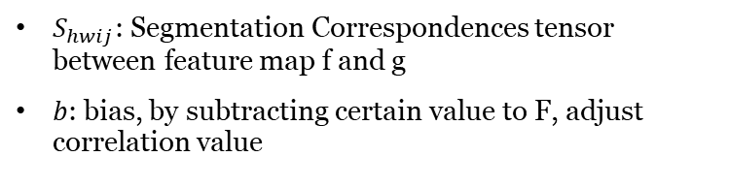
2. Model
$S_{hwij}$: Segmentation Correspondences tensor between feature map f and g
$b$: bias, by subtracting certain value to F, adjust correlation value

Slide 11
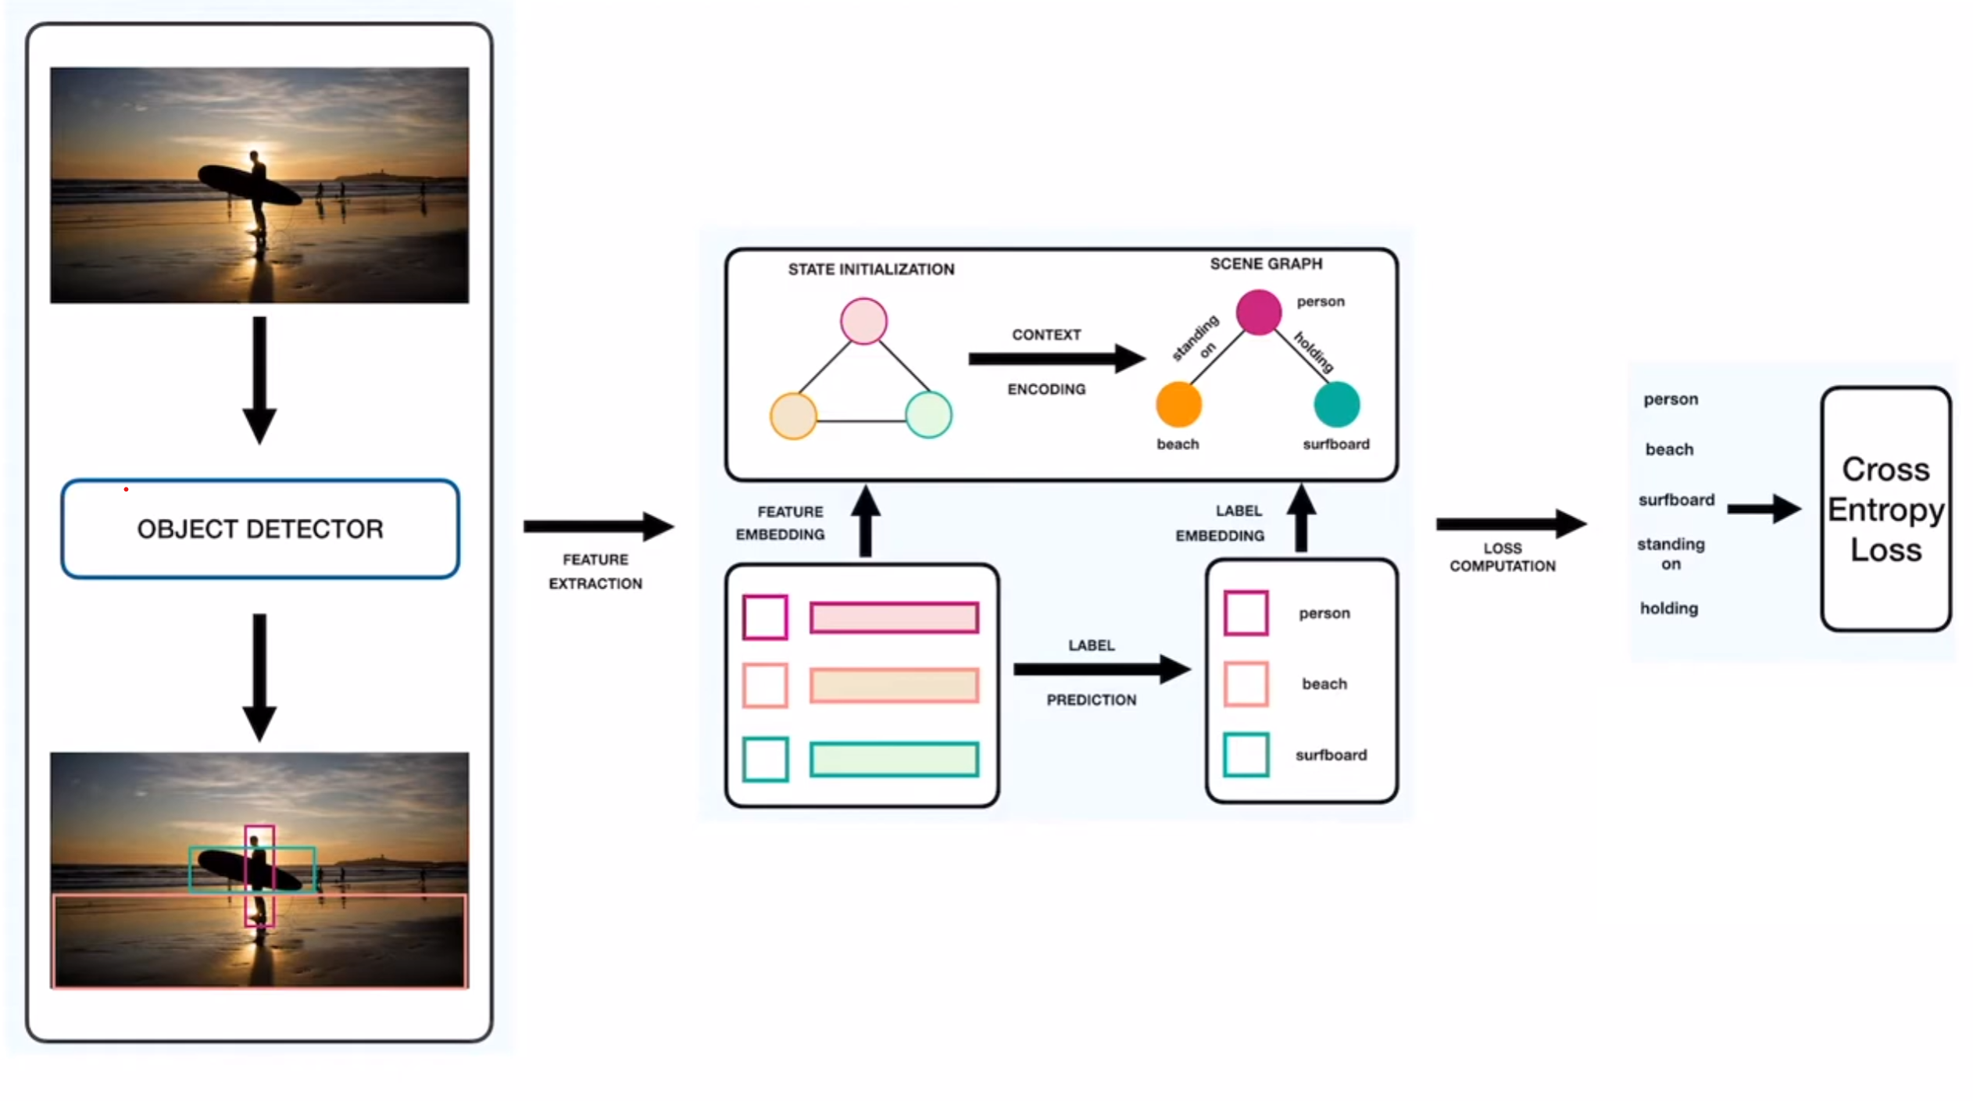
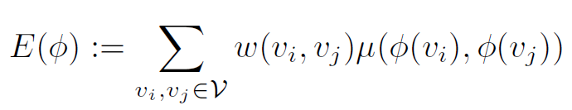
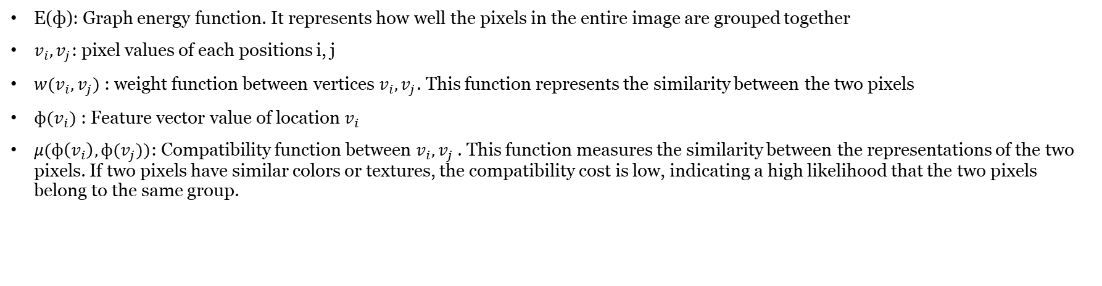
2. Model
E(ф): Graph energy function. It represents how well the pixels in the entire image are grouped together
$v_{i},v_{j}$: pixel values of each positions i, j
$w(v_{i},v_{j})$: weight function between vertices $v_{i},v_{j}$. This function represents the similarity between the two pixels
$ф(v_{i})$: Feature vector value of location $v_{i}$
$μ(ф\left(v_{i}\right),ф(v_{j}))$: Compatibility function between $v_{i},v_{j}$​. This function measures the similarity between the representations of the two pixels. If two pixels have similar colors or textures, the compatibility cost is low, indicating a high likelihood that the two pixels belong to the same group.

Slide 12
2. Model

Slide 13
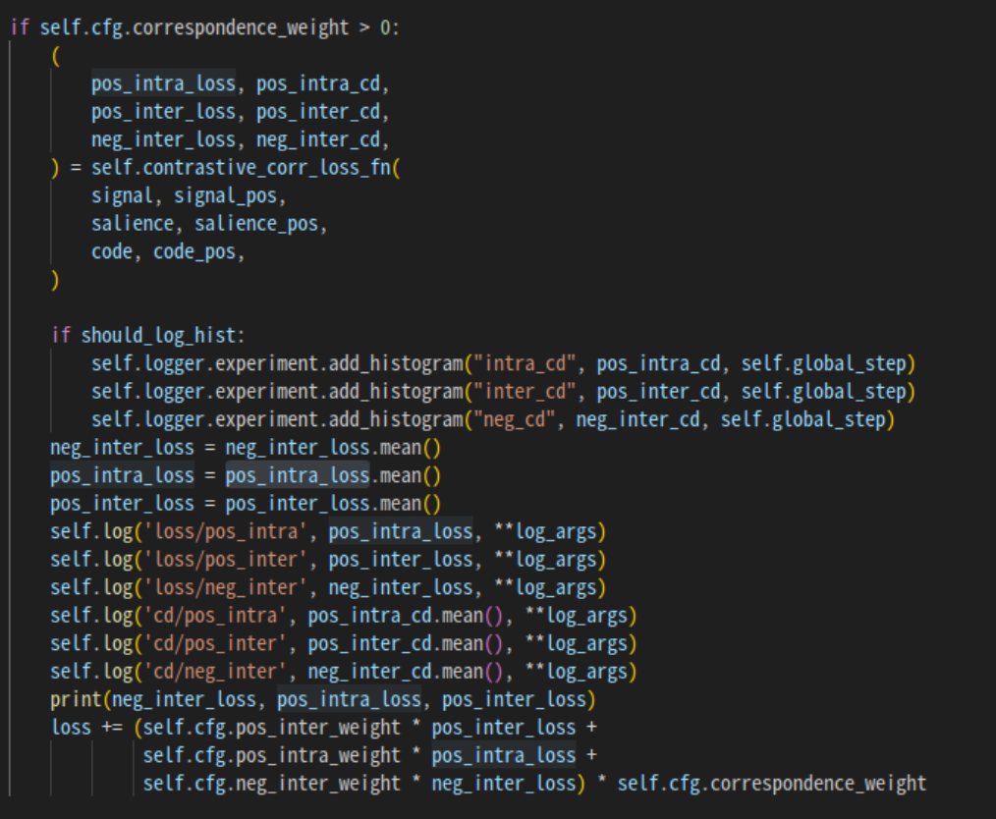
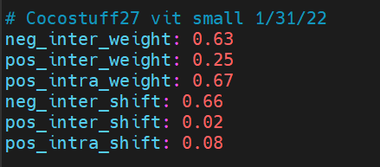
2. Model
tensor(0.0895, device='cuda:0', grad_fn=<MeanBackward0>) tensor(-0.2202, device='cuda:0', grad_fn=<MeanBackward0>) tensor(-0.2264, device='cuda:0', grad_fn=<MeanBackward0>)
tensor(0.0876, device='cuda:0', grad_fn=<MeanBackward0>) tensor(-0.2981, device='cuda:0', grad_fn=<MeanBackward0>) tensor(-0.2882, device='cuda:0', grad_fn=<MeanBackward0>)
tensor(0.0892, device='cuda:0', grad_fn=<MeanBackward0>) tensor(-0.3084, device='cuda:0', grad_fn=<MeanBackward0>) tensor(-0.3044, device='cuda:0', grad_fn=<MeanBackward0>)
tensor(0.0782, device='cuda:0', grad_fn=<MeanBackward0>) tensor(-0.3080, device='cuda:0', grad_fn=<MeanBackward0>) tensor(-0.3030, device='cuda:0', grad_fn=<MeanBackward0>)
tensor(0.1059, device='cuda:0', grad_fn=<MeanBackward0>) tensor(-0.2755, device='cuda:0', grad_fn=<MeanBackward0>) tensor(-0.2740, device='cuda:0', grad_fn=<MeanBackward0>)
tensor(0.0823, device='cuda:0', grad_fn=<MeanBackward0>) tensor(-0.2762, device='cuda:0', grad_fn=<MeanBackward0>) tensor(-0.2732, device='cuda:0', grad_fn=<MeanBackward0>)

Slide 14
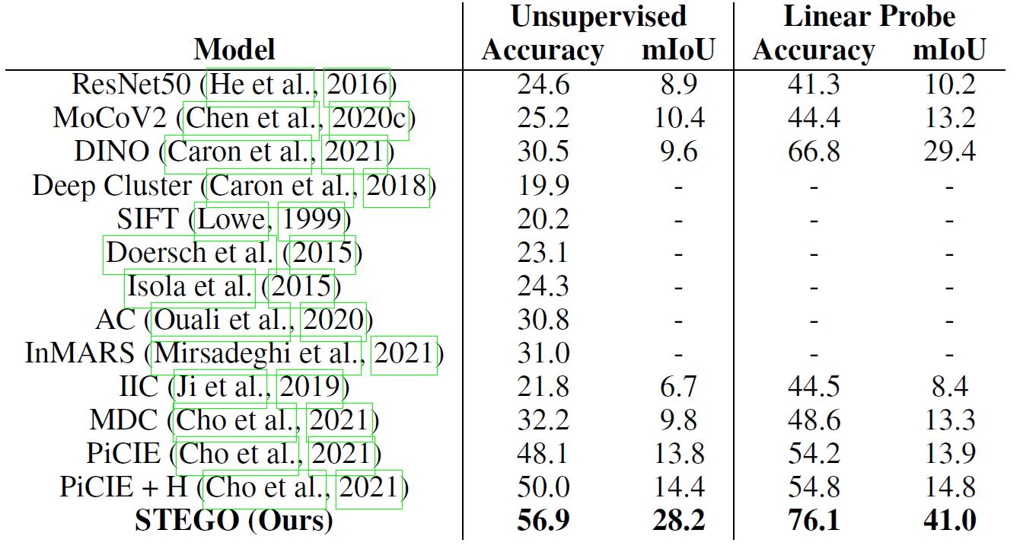
3. Conclusion

Slide 15
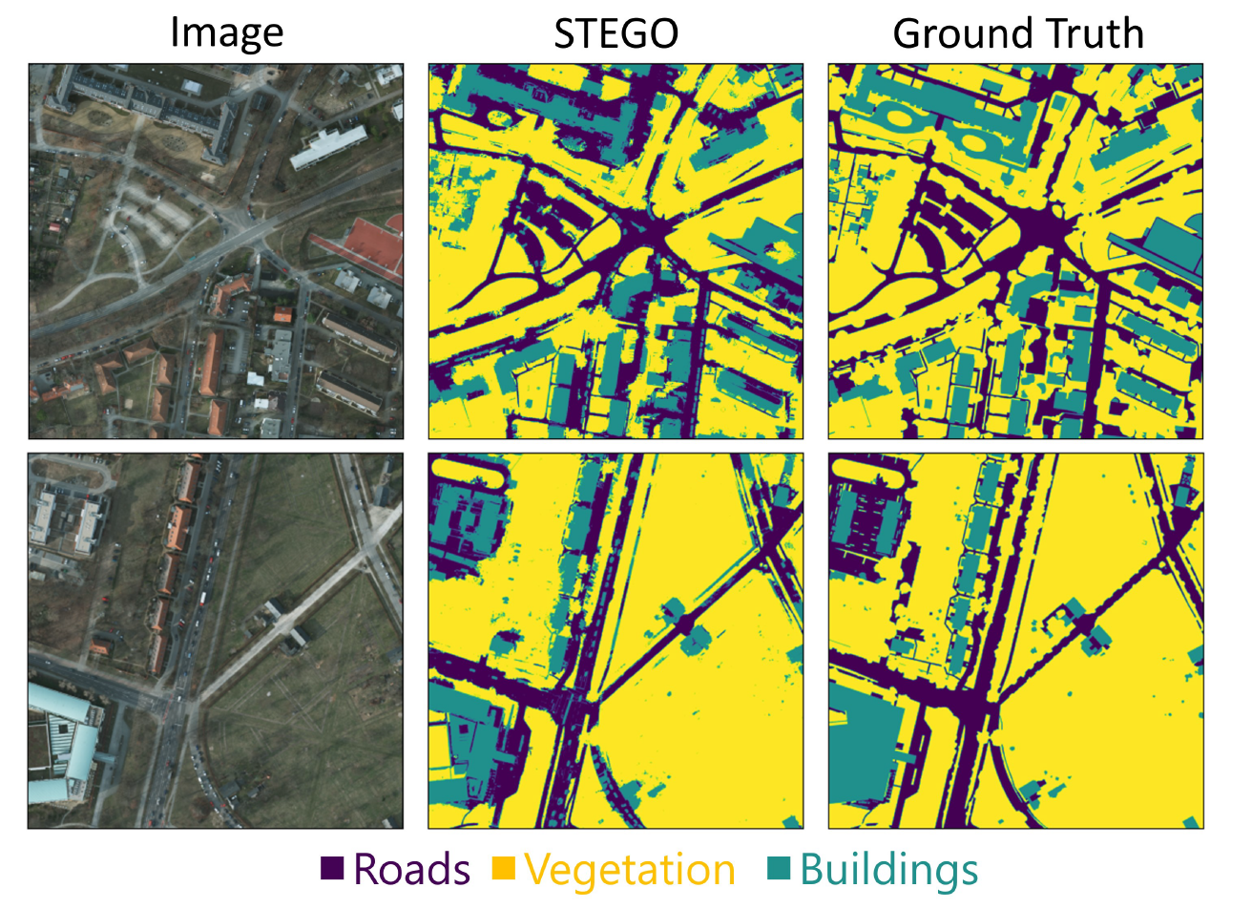
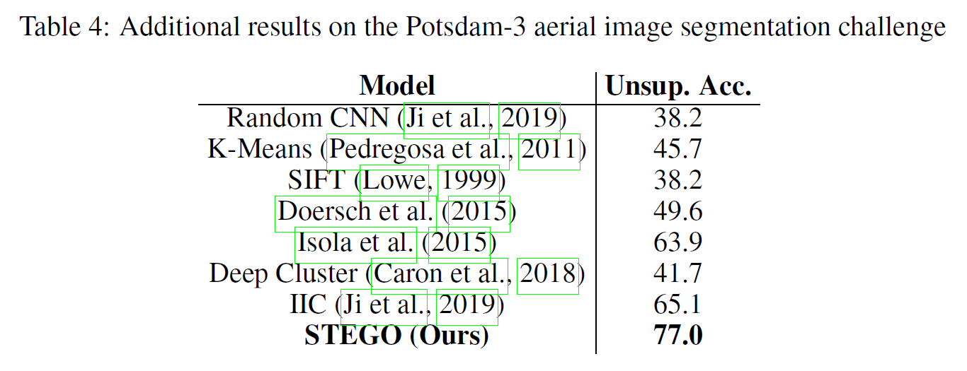
3. Conclusion

Slide 16
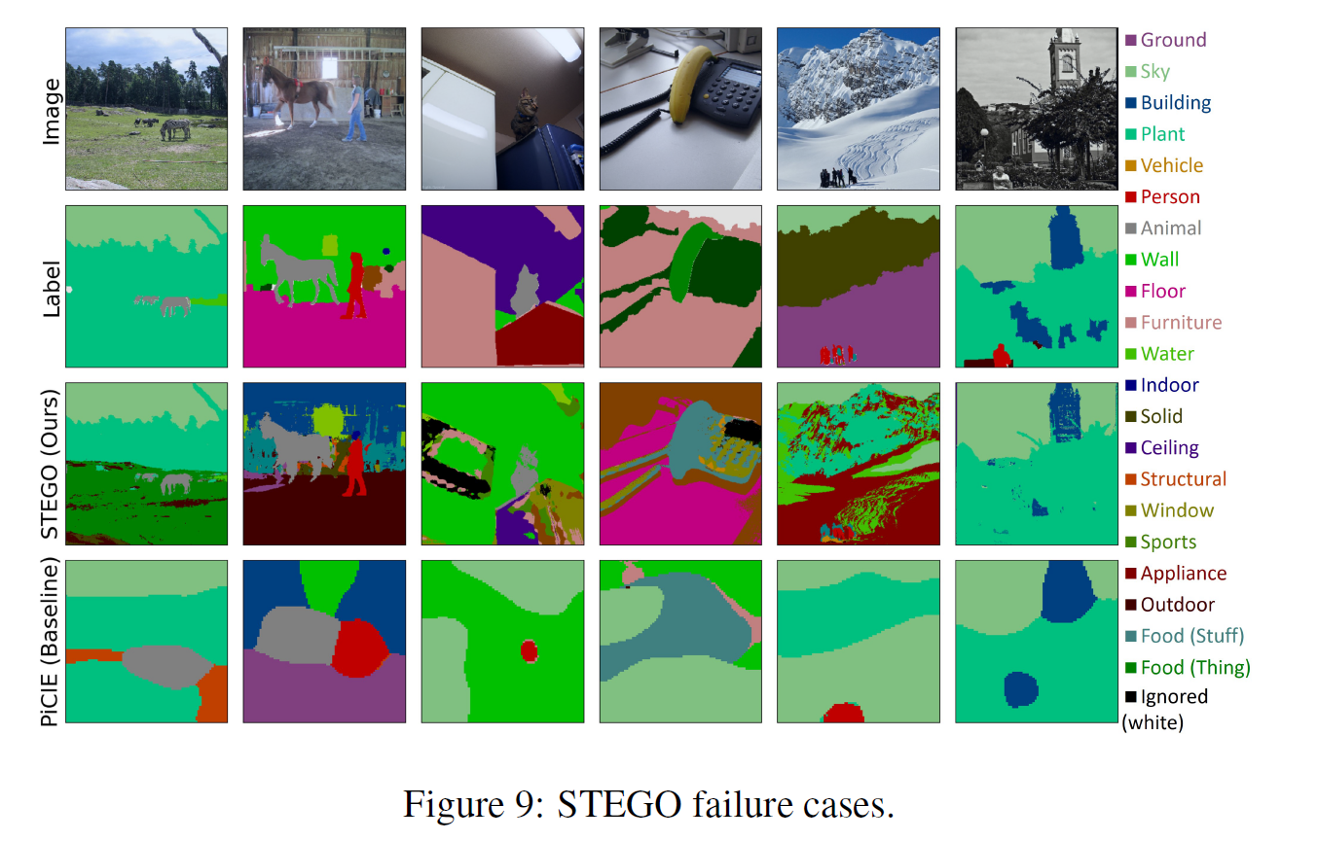
3. Conclusion

Slide 17
3. Conclusion
Necessary for effectively recognize and extract various and complex patterns from images
Manually labeling the data is too challenging and need much time
Automatically mask pattern areas and cluster similar patterns for use in anomaly detection training
Grouping similar patterns together for training is expected to enhance the performance of the anomaly detection model
Example image

Slide 18
Thank you

